Slide 1
Peak Detection
Notes:
<number>

Slide 2
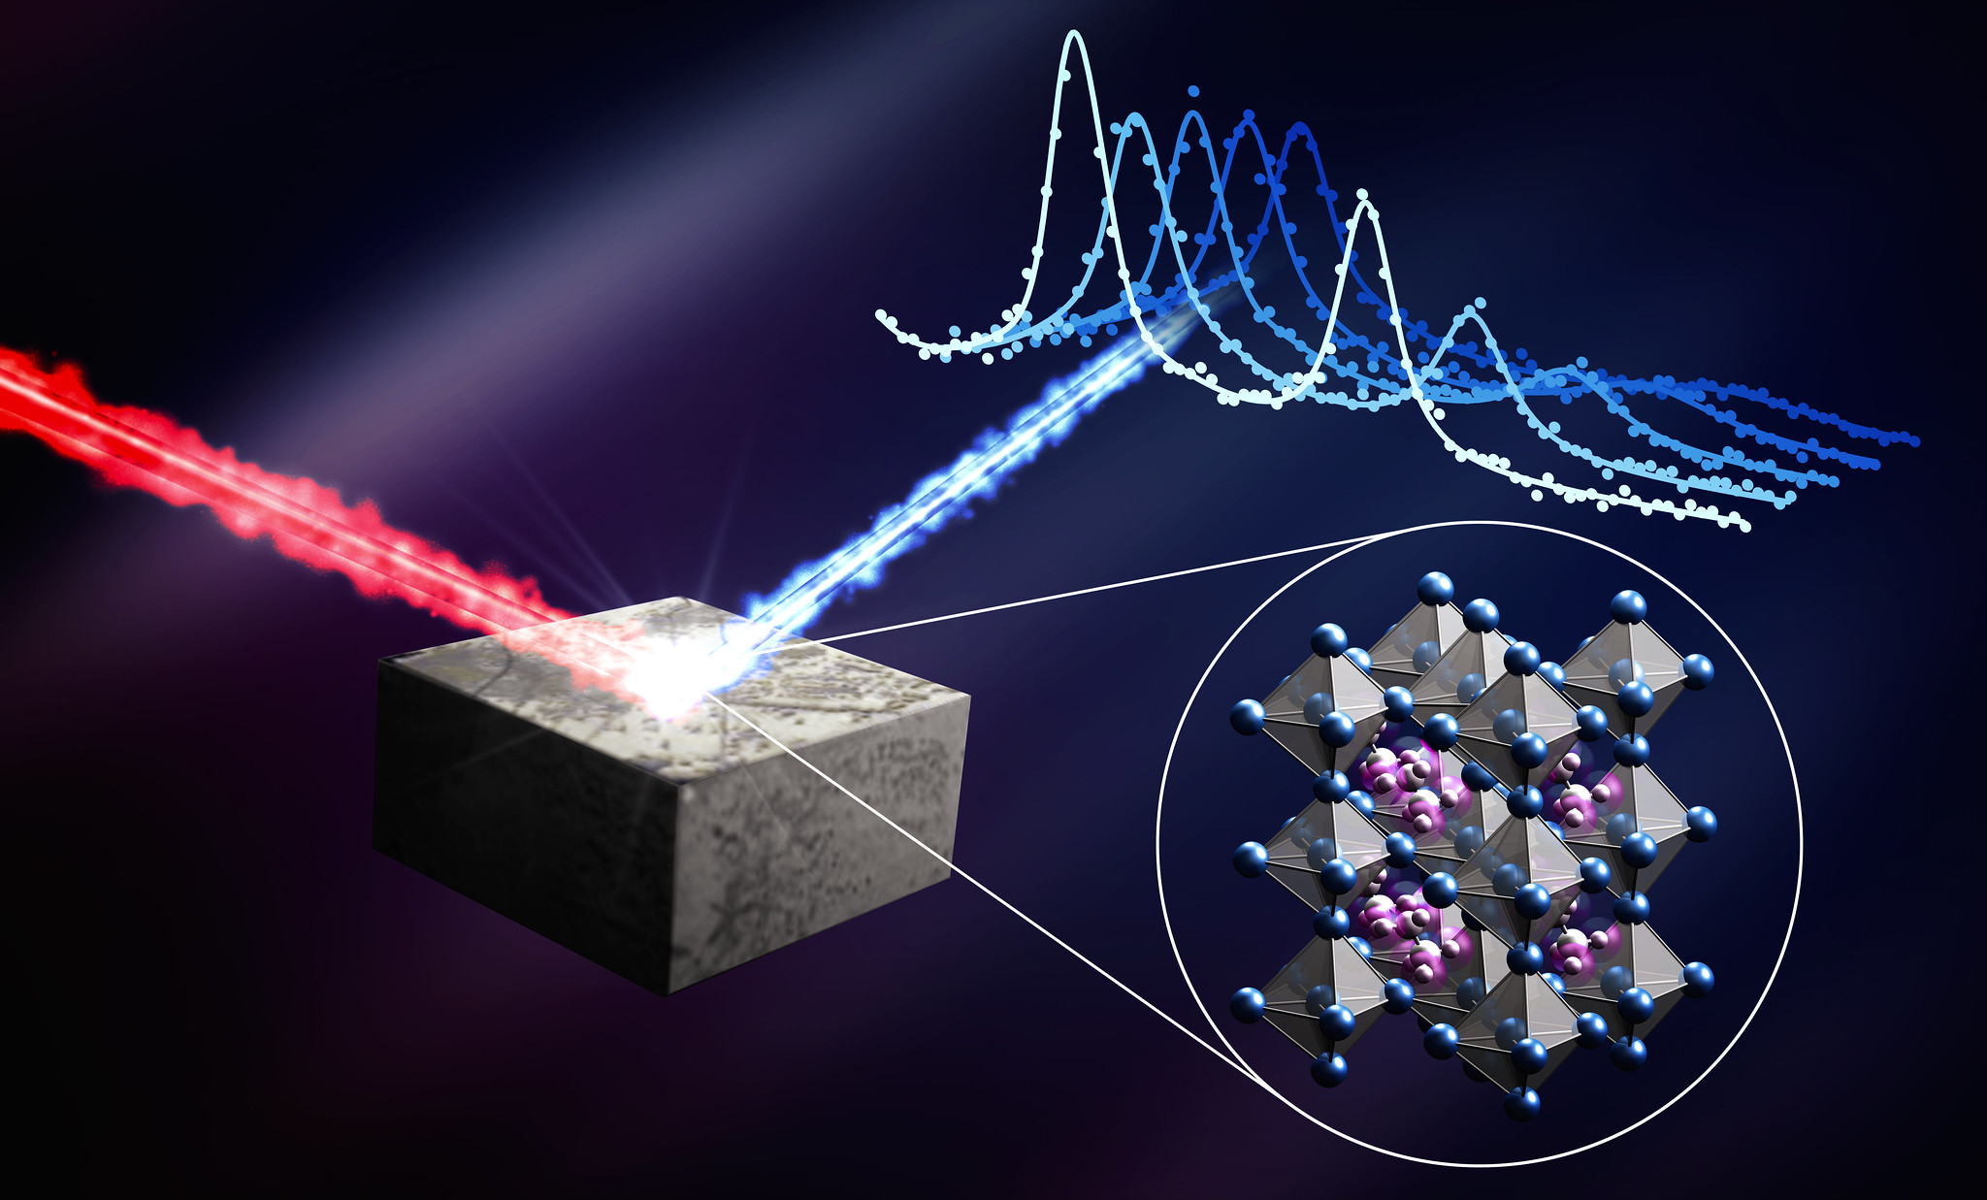
Motivation
Automated Diffraction Data Clustering
Save time
Key region detection
Efficient data collection
<number>
Notes:
<number>

Slide 3
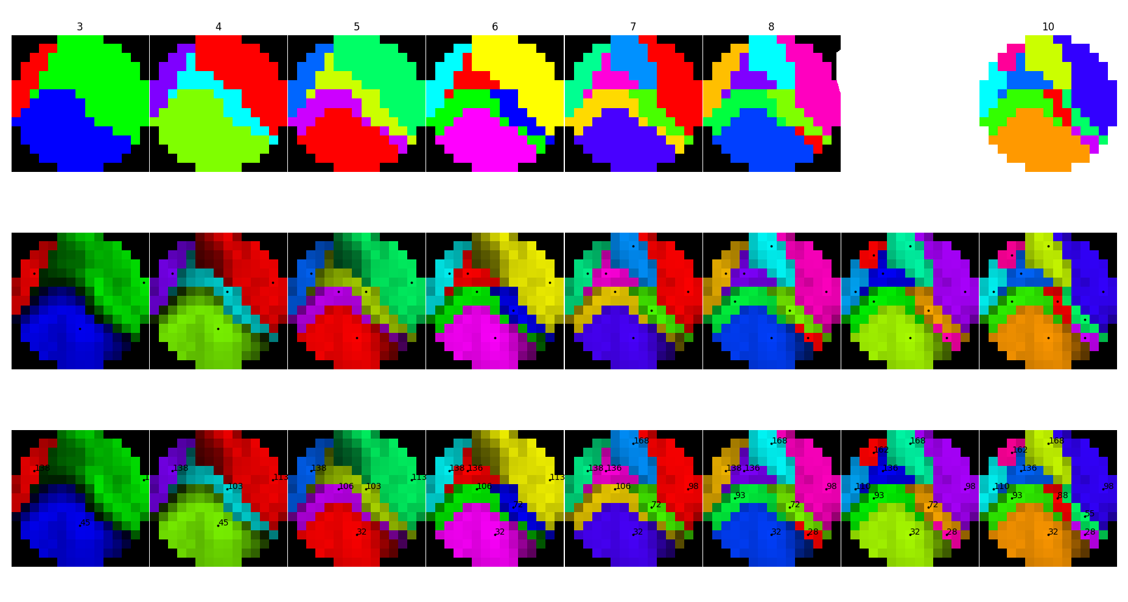
Motivation
Automated Diffraction Data Clustering
Save time
Key region detection
Efficient data collection
<number>
Notes:
<number>

Slide 4
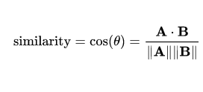
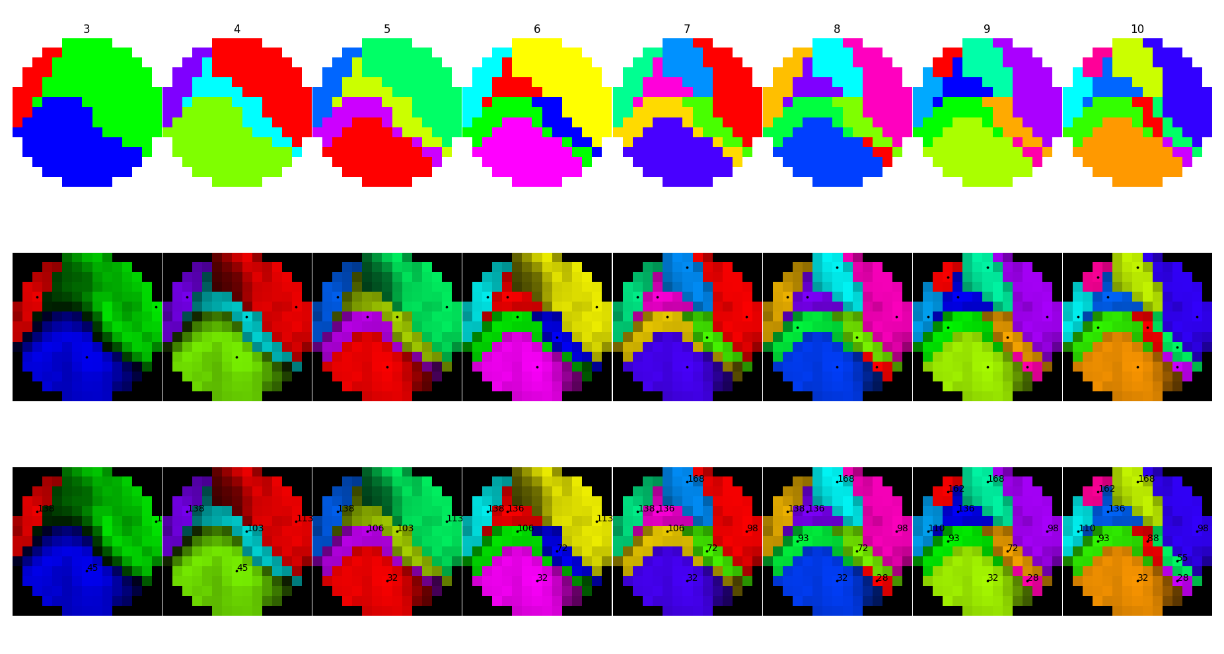
Cosine Based Clustering
Agglomerative Clustering on Similarity Matrix
<number>
Notes:
<number>

Slide 5
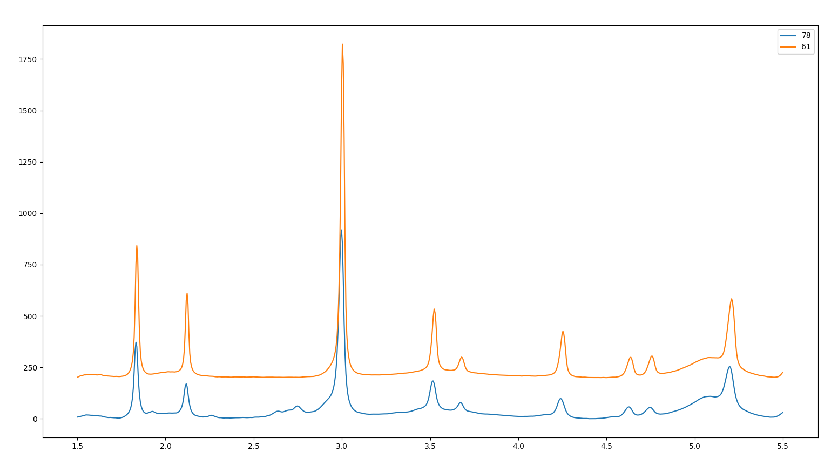
Cosine Based Clustering
Agglomerative Clustering on Similarity Matrix
92% Similar
<number>
Notes:
<number>

Slide 6
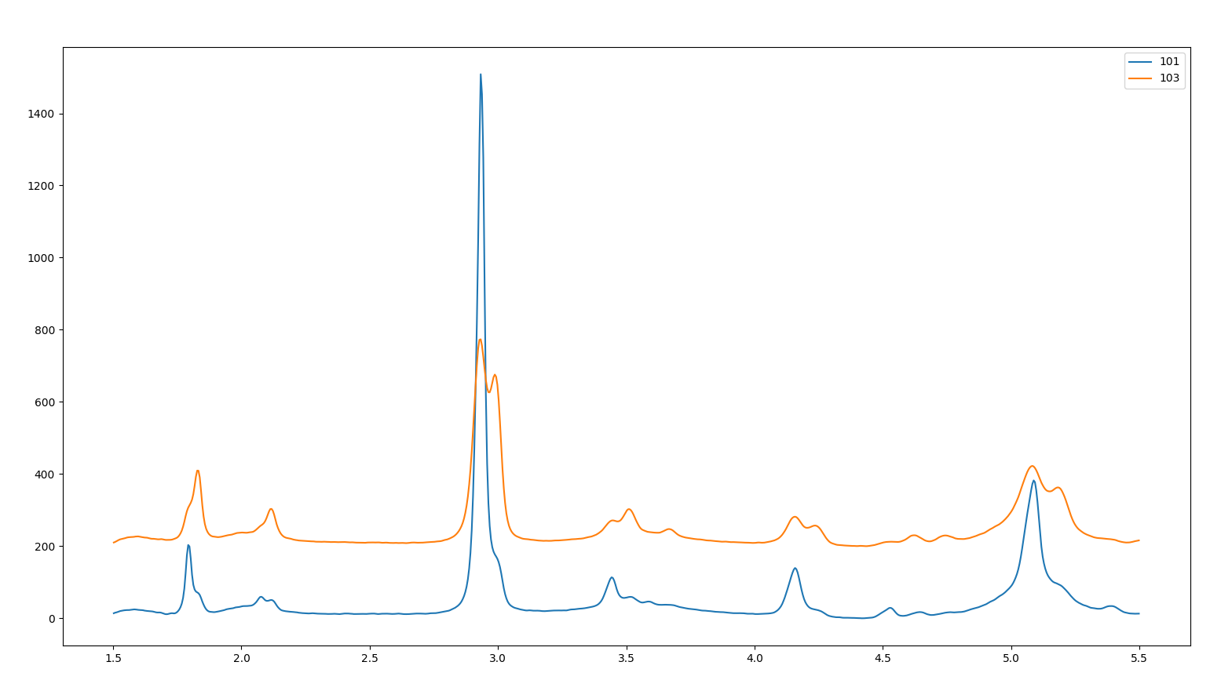
Cosine Based Clustering
Agglomerative Clustering on Similarity Matrix
85% Similar
<number>
Notes:
<number>

Slide 7
Bayesian Block Analysis and Peak Fitting
Bayesian Block Analysis and Peak Fitting
<number>
Notes:
<number>

Slide 8
Challenges of detecting peaks
What makes this a hard task?
<number>
Notes:
<number>

Slide 9
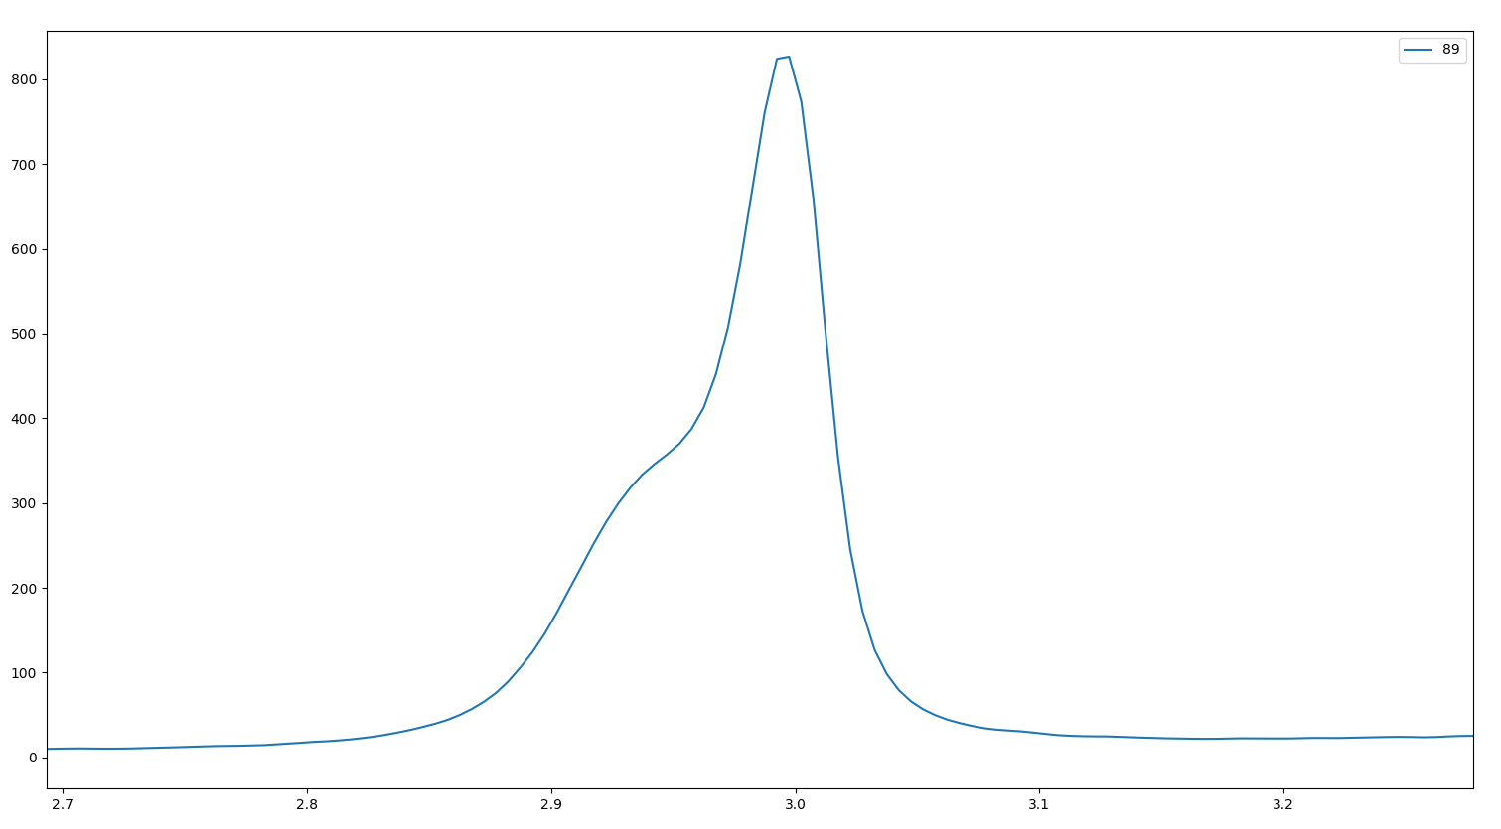
Challenges of detecting peaks
What makes this a hard task?
Overlapping Peaks
<number>
Notes:
<number>

Slide 10
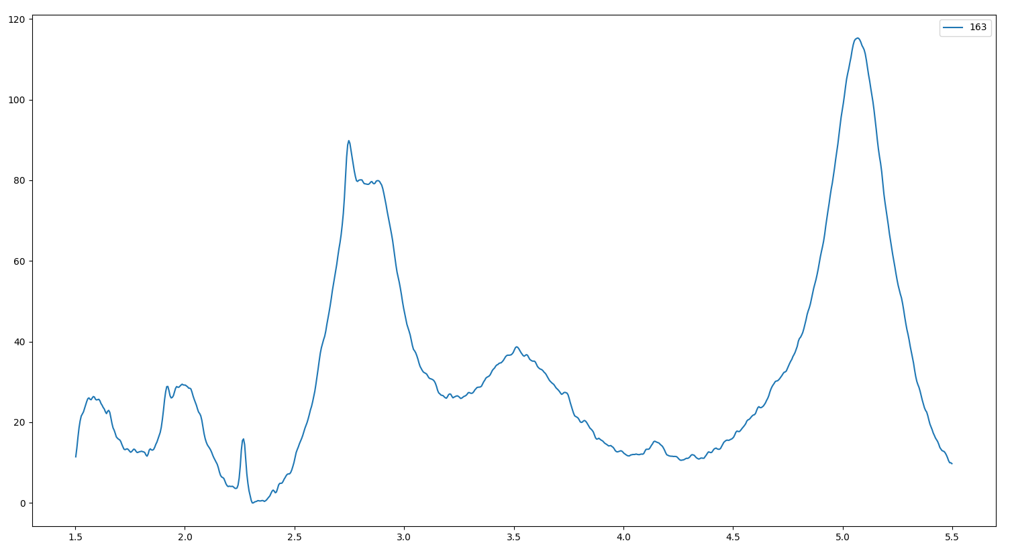
Challenges of detecting peaks
What makes this a hard task?
Overlapping Peaks
Noisy Data
<number>
Notes:
<number>

Slide 11
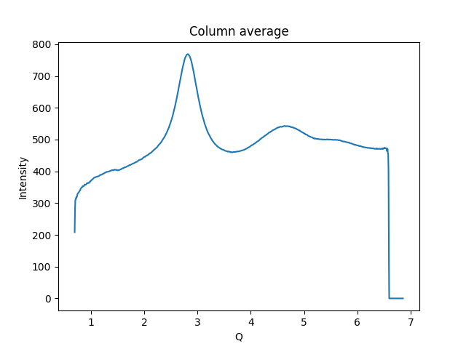
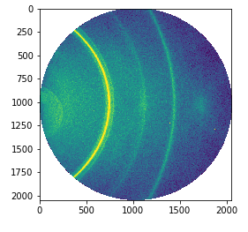
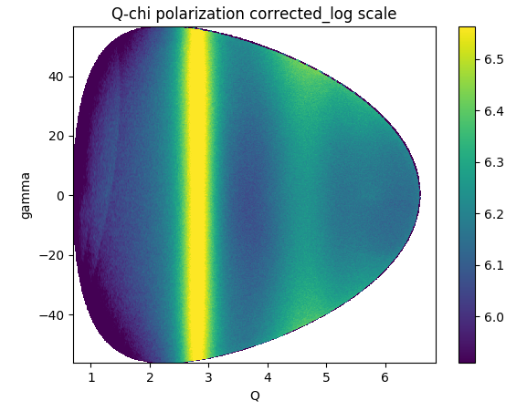
Preprocessing
<number>
Notes:
<number>

Slide 12
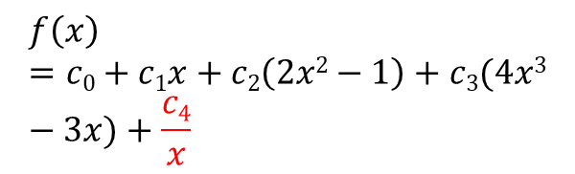
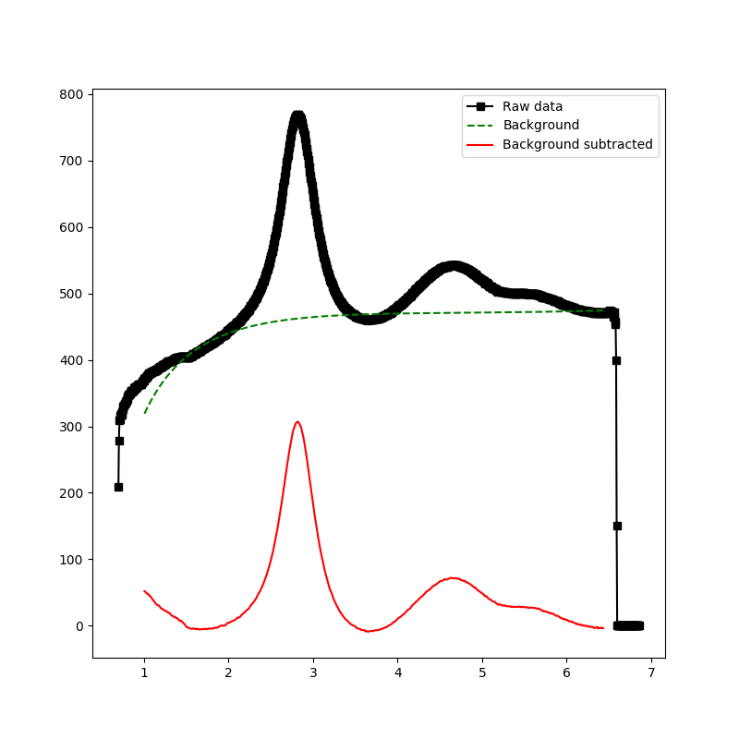
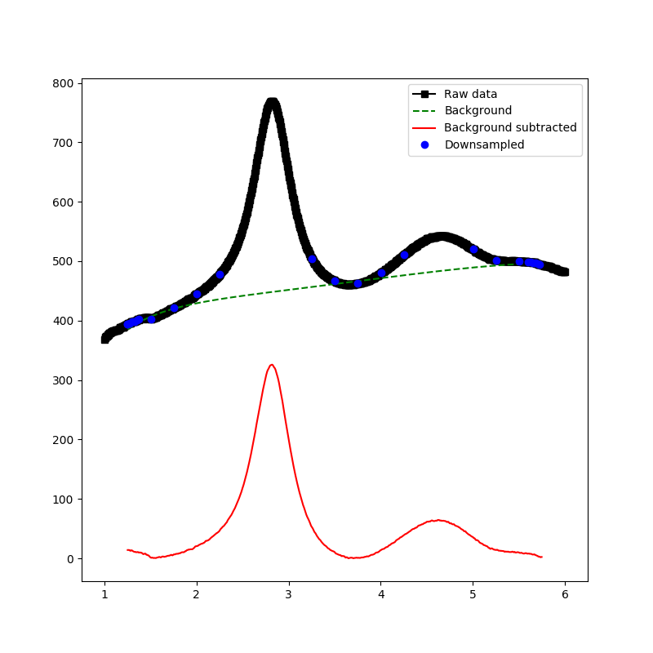
Preprocessing
Modified Chebyshev Polynomial
Take points below median
Emphasize edge points to pin edges of function
<number>
Notes:
<number>

Slide 13
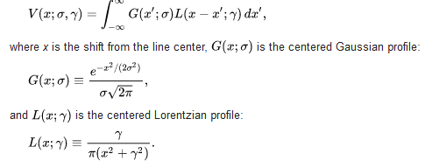
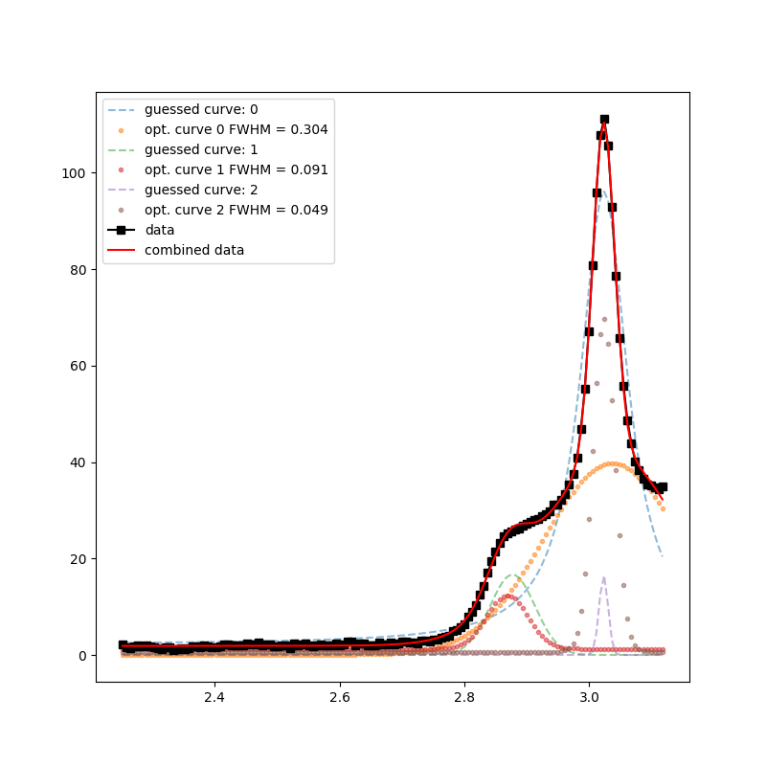
Peak Fitting
Voight Profile
Fixed Curve Number
Place curve at peak in data
Subtract curve to get new data
Repeat until all curves are placed
Optimize all curves together on original data

Slide 14
Peak Fitting
Voight Profile
Fixed Curve Number
Place curve at peak in data
Subtract curve to get new data
Repeat until all curves are placed
Optimize all curves together on original data
Variable Curve Number
Fit curves until:
No statistical difference in residual
Maximum number of curves placed
Optimize all curves together

Slide 15
Peak Fitting
Voight Profile
Fixed Curve Number
Place curve at peak in data
Subtract curve to get new data
Repeat until all curves are placed
Optimize all curves together on original data
Variable Curve Number
Fit curves until:
No statistical difference in residual
Maximum number of curves placed
Optimize all curves together

Slide 16
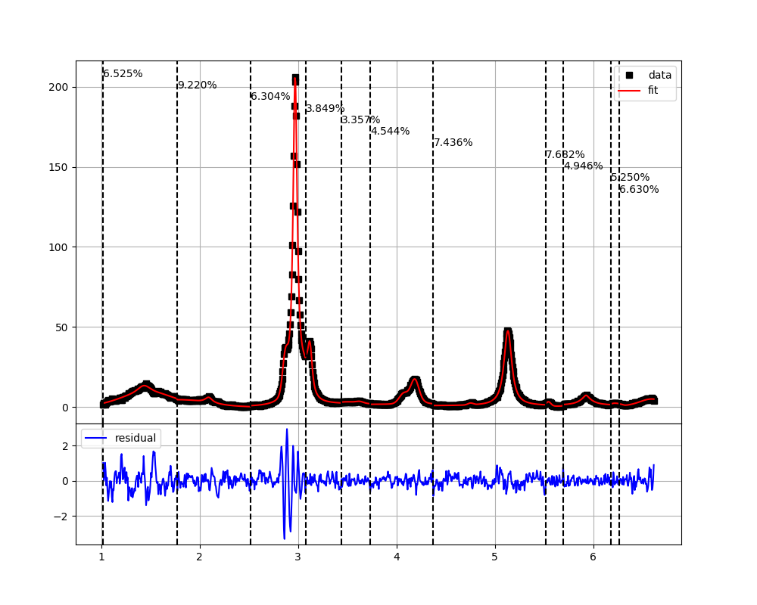
Bayesian Block Analysis
BBA Algorithm
1
2
3
<number>
Notes:
<number>

Slide 17
Results
Does it work?
<number>
Notes:
<number>

Slide 18
Results
Does it work?
Sometimes...
<number>
Notes:
<number>

Slide 19
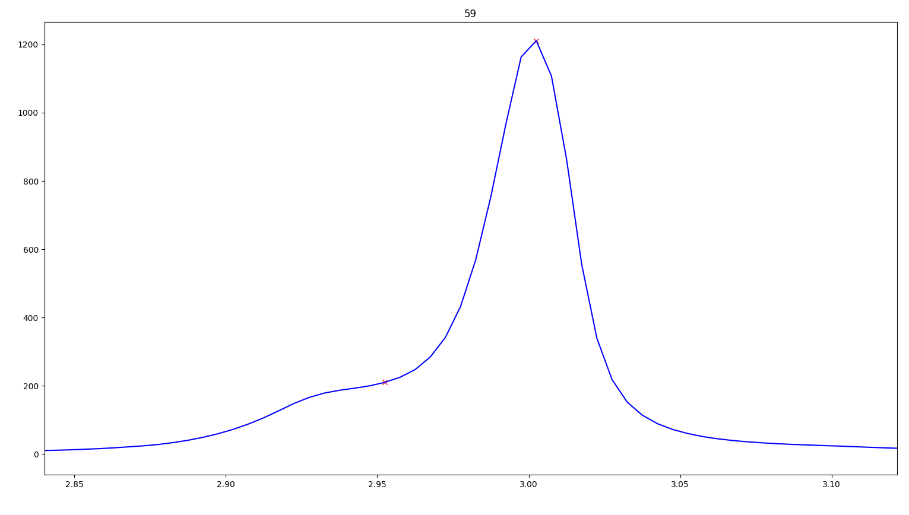
Results
<number>
Notes:
<number>

Slide 20
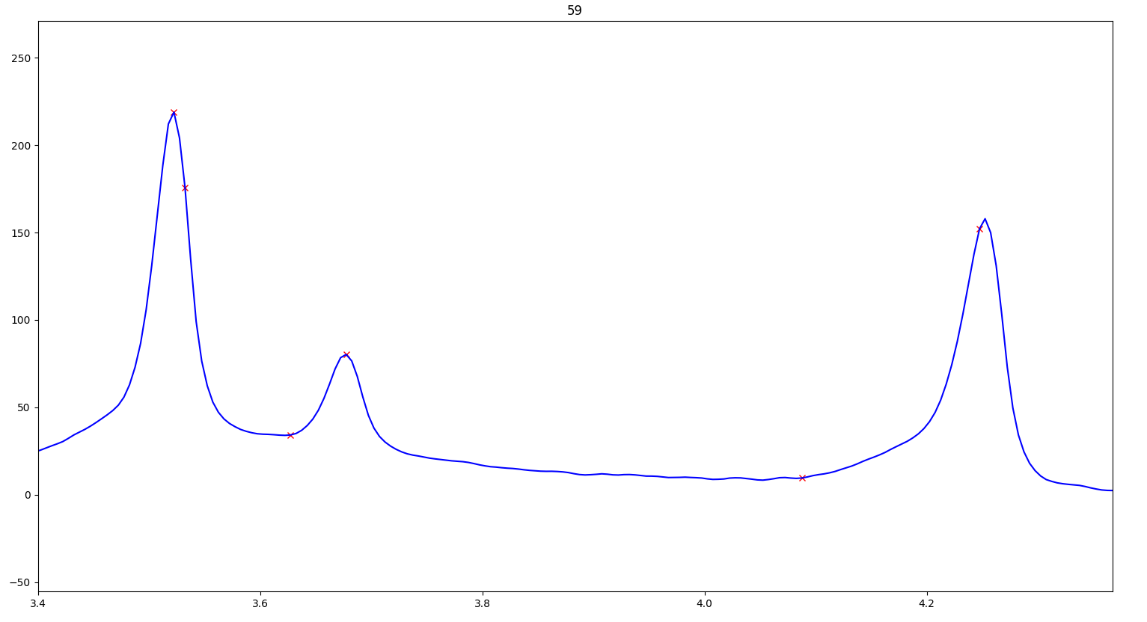
Results
<number>
Notes:
<number>

Slide 21
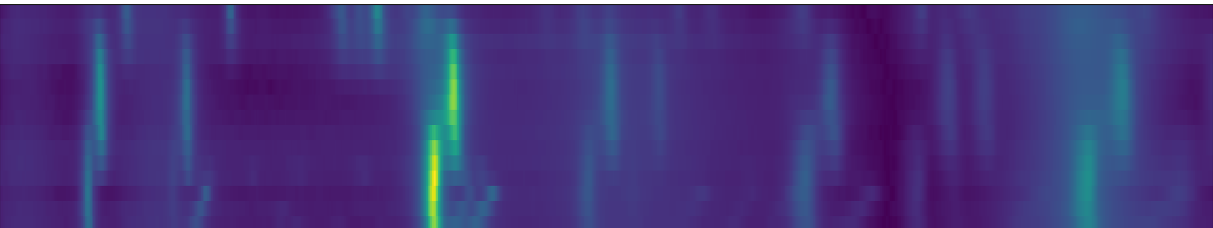
Further Directions
Improved Peak Detection
Better blocking
Peak fitting constraints
Higher dimensional peak fitting
<number>
Notes:
<number>

Slide 22
Full-Column, Bulleted Slide
This PowerPoint template is one example of SLAC’s visual identity guidelines, which were introduced to:
Automated Clustering
Create a strong, modern brand that distinguishes SLAC as a leader in scientific discovery
The complete visual identity guidelines are available on the Office of Communications website, as well as:
Letterhead template
Business card template
Logo files
Please email communications@slac.stanford.edu with any questions or feedback.
<number>
Notes:
<number>

Slide 23
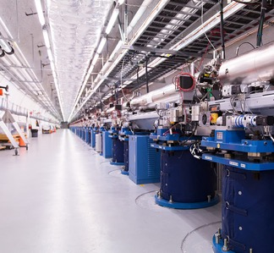
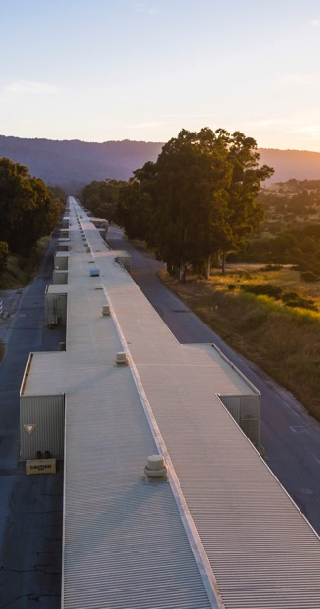
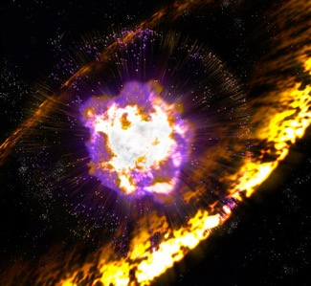
Two column, two-line headline Instructions on finding and using images
Find SLAC’s best images organized into albums on SLAC’s official Flickr channel: slaclab/albums flickr.com/photos/slaclab
SLAC’s full photo archive can be found on SALLIE, the Stanford ALL Image Exchange: sallie.stanford.edu
Images on Flickr and SALLIE are available for employee use in professional presentations
<number>
Notes:
<number>

Slide 24
Increasing Our Scientific Impact Over the Next Decade
LABORATORY GOALS
Be the world leader in X-ray and ultrafast science and in our selected areas of accelerator science and high energy physics
Expand and increase our impact in Office of Science mission areas by leveraging our world-leading core capabilities and expertise
Broaden and strengthen our impact across critical national needs by using our position within Stanford and Silicon Valley
Be the “best-in-class” DOE lab for safe, efficient and innovative operations that align with and enable our research mission
<number>
Notes:
<number>

Slide 25



Divider page INSERT PREFERRED IMAGE AS BACKGROUND – INSTRUCTIONS: 1: Click “Insert” from menu and choose “Picture” to select image 2: Once image is inserted, right-click image and choose ‘Send to Back’
3: Delete or replace this text with a divider title
Notes:
<number>

